Slide 1


DUAL
CREDIT
at Dulles High School
Dr. Kasha Williams - CCRA

Slide 2


Slide 3
What is Dual Credit?
Opportunity for high school students to take college level courses while in high school
Academic core courses are transferable to Texas public universities and most out of state colleges
Grades earned in Dual Credit go on two transcripts: Your high school transcript and your HCC college transcript.

Slide 4
Dual Credit Courses at DHS on campus in fall
We have 4 Dual (Tentative*) Credit Courses:
US History (11)
Humanities* (11, 12)
English 4 (12)
Government (12)
Courses offered are dependent on student interest!
If you are interested, PLEASE select DC courses during course selection.

Slide 5
Dual Credit Courses at hcc in summer
You have 6 Dual Credit Course Options:
Psychology (10+)
Sociology (10+)
Speech (10+)
Humanities (11+)
Government (12)
Economics (12)

Slide 7
Cost of Courses free*
HCC provides an in-district tuition waiver for DC students; FBISD covers the out-of-district fee that HCC charges. This is not paid by FBISD until after you have completed the semester course – so do not pay this portion of fees owed on your HCC account.
All DC students must pay for their textbooks. Each instructor will inform students which books are required. Some are included in the HCC Canvas platform This part you must pay.

Slide 8
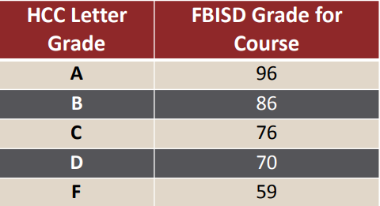
Grading
Students will be awarded an extra 10 points weight to their high school GPA at the end of the semester.

Slide 10
***SUMMER SELF-Enrollment*** extremely important rules!
Available in April/May. We will have a SUMMER Dual Credit assembly to cover proper enrollment.
Do not enroll in classes that won’t count and won’t be free!
  Absolutely no mini-mester courses.
  All courses MUST be on the crosswalk.
  No College Algebra in summer. No U.S. History. No English 4.
June session and July session. Up to 1.0 total credits.
You are doing this on your own! Login to your Canvas daily. There are no summer reminders. The professor will drop you for non-attendance or not logging in.
Online Anytime vs Online on a Schedule vs Face-to-Face (Meningitis waiver)

Slide 11
Can I Drop/Withdraw From a Course?
Yes – there are two specific drop deadlines for HCC Courses.
DROP is 10 days from the start of class – nothing will show on your HCC transcript; your counselor can transfer you to a regular course if this is a class required for graduation
WITHDRAWAL is later into the semester and will show as a W on your HCC transcript; depending on when you withdraw, you may need to be enrolled in an online Edgenuity class to complete the credit needed.
You can only have 6 total W’s in your entire college career so think about whether these classes are best for you.

Slide 13
Next steps always check the ccr website!
PUT THE COURSE IN SCHOOLINKS. CLOSES 2/13!
APPLY TO HCC ON APPLYTEXAS.ORG. PACKET LOCATED ON CCR WEBSITE. FOLLOW THE PACKET! AVAILABLE 2/6.
  Double check your email address for acceptance email.
  Double check you are enrolled in the correct TERM! Summer 2026 vs Fall 2026
  Double check the correct application type – DUAL CREDIT STUDENT
  Your Academic Program MUST be Undecided, Degree = Liberal Arts. You are NOT degree-seeking.
  WAIT FOR YOUR W# from HCC. It is in YOUR welcome email. Nothing comes to us!
SUBMIT YOUR DULLES ONLINE FORM. LOCATED ON CCR WEBSITE. AVAILABLE 2/13.
  Upload transcript from Skyward Portfolio
  Upload HCC Lifetime Waiver (parent MUST sign)

